Slide 1
Global Brand Marketing Strategies –CAT II topics

Slide 2
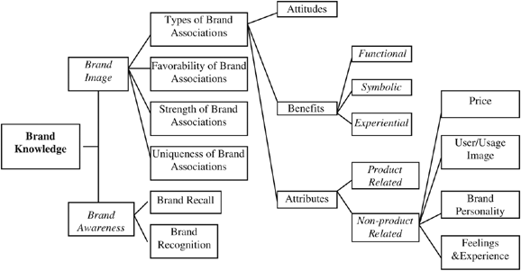
Brand knowledge (Keller)

Slide 3
How Important is brand awareness?
“Nearly 1 out of 2 Indians haven’t heard about Apple . Can you believe it ?”
(Business Insider India, April 23, 2016, based on Morgan Stanley research)

Slide 4
Sources of Brand equity:
Brand Awareness
Brand recognition : Can you recognise the brand at the store to which you have been already exposed ?
Brand recall : ability to retrieve a brand given pdct category ,usage situation as cue
Learning Advantage
Plants a brand node in memmory and then links up associations
Consideration advantage
Consideration set –
‘Part list cueing effect”-recall of some info can inhibit some other info
Choice advantage
May adopt a decision rule to buy familiar brands
ELM – when consumers lack “purchase ability “and “motivation”

Slide 5
Brand Image
Strength of Brand Associations
Related to personal relevancy and consistency
Brand attributes and Brand Benefits
Direct experiences and W-o-M
Favourability of Brand Associations
Desirability (how relevant/distinctive/ believable?)
Deliverability
Uniqueness of Brand Associations
Whether brand has sustainable competitive advantage or USP?

Slide 6
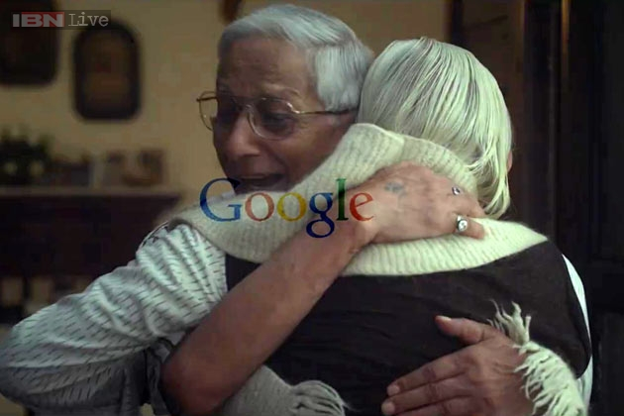
Google’s viral ad – a subtle attempt for an image makeover – the “goodness” of its products

Slide 7
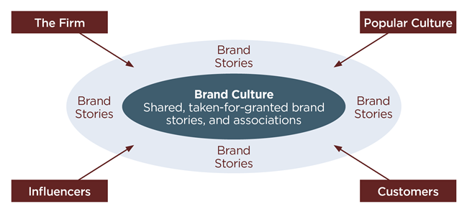

Slide 8
Brand Building Blocks
Keller’s Brand Resonance pyramid

Slide 9
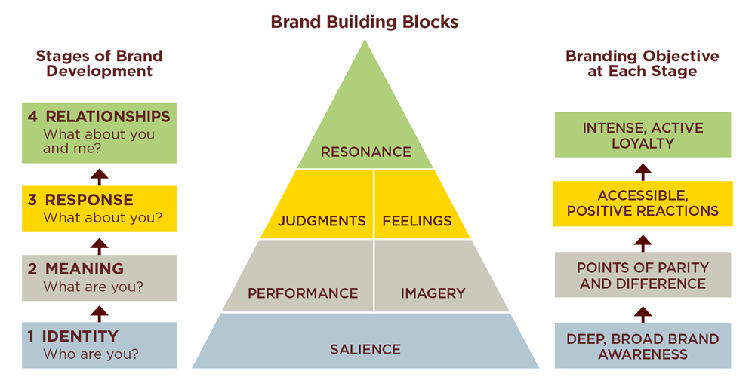

Slide 10
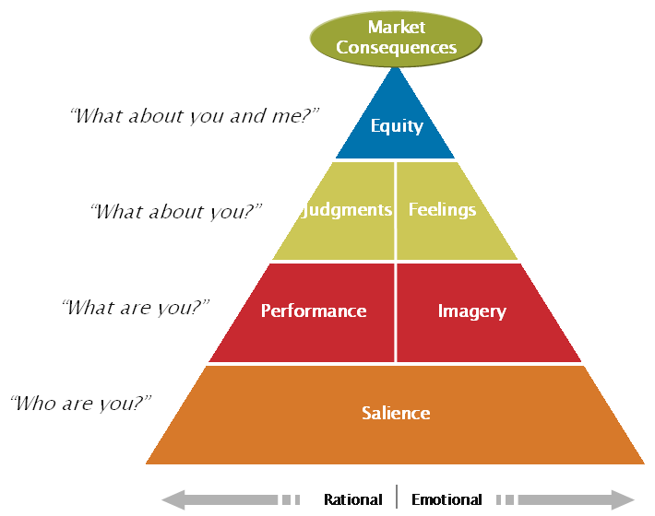

Slide 11
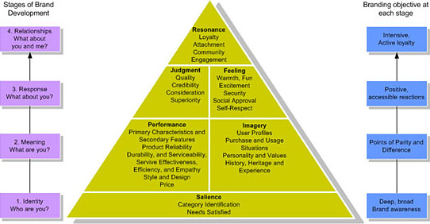

Slide 12
Six Brand Building Blocks
Brand Salience
Performance
Imagery
Brand Judgements
Brand Feelings
Resonance

Slide 13
Salience
To what extend brand is ToM and easily recalled or recognized?
Depth of awareness: How likely brand element comes to mind? The ease with which it does?
Breadth of awareness:
Range of purchase and usage situations
Product category structure
A highly salient brand has associations formed from the consumer’s own experience or thru ads or w-o-m

Slide 14
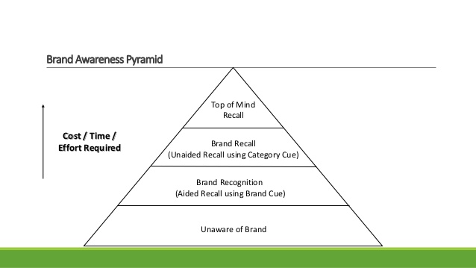

Slide 15
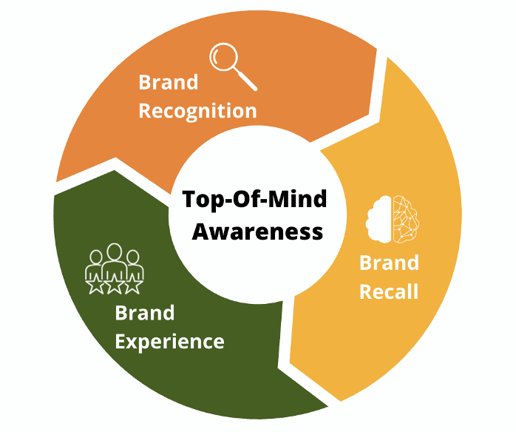
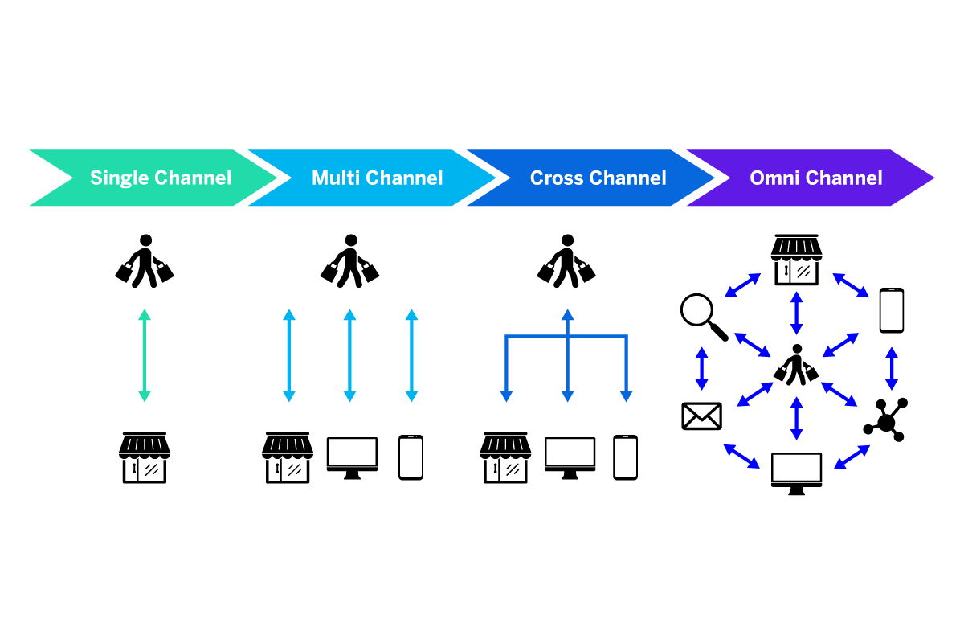

Slide 16
Brand performance
Describes how well the product or service meets customer’s more functional needs.
Brand Imagery
Depends on extrinsic properties ,the ways in which brand attempts to meet consumer’s psychological or social needs
The way consumers think about a brand abstractly
Intangible aspects of brands
Semiotics
Aspirational ? Gender? Age specific? Young ,affluent ,professional ?
Psychographic …attitude towards Life ,posessions ,career,social issues ?
?

Slide 17
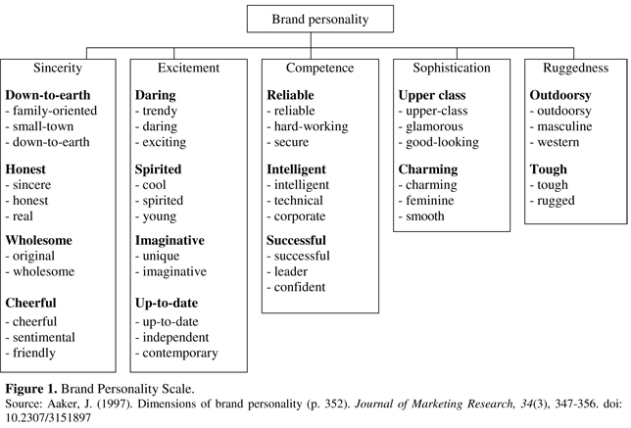

Slide 18
#share the load –Ariel
Aspirational masculinity vs new roles
Patriarchal to playfulness- Kidults

Slide 19
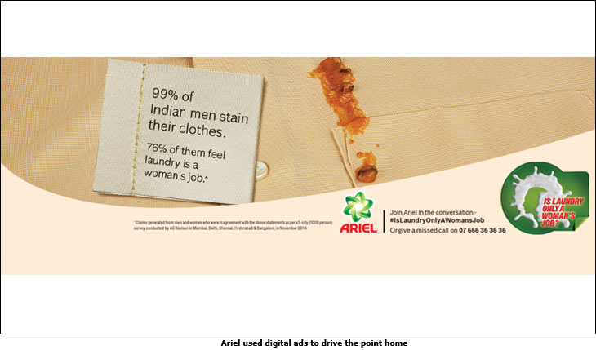

Slide 20
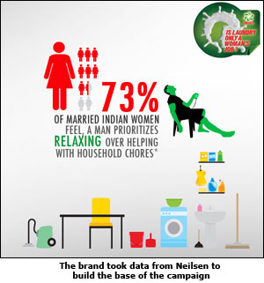

Slide 21
Brand judgements
Consumer’s personal opinion about evaluations of the brand by putting together all performance and imagery associations
Brand quality /Credibility /Consideration/superiority

Slide 22
Brand Feelings
Emotional responses and reactions to the brand
“transformational advertising”

Slide 23
Brand Feelings …some insights
Brand attitudes can be extremly polarizing,and it takes firms by surprise
Brand polarization (Luo et al , HBR,Nov 13)..managers should stop relying on averages
Craft’s Social media strategy for Miracle Whip ,Love ‘them or hate them campaign
“I Love it “ vs “I would rather lick ur shoes”
Its good to have haters !
Similarities with political campaigns
Brand Dispersion
Strategies : Poke the haters (Ryan Air )/ /Amplify a polarizing attitude ..new products that amplify points of differentiation/polarizing ad

Slide 24
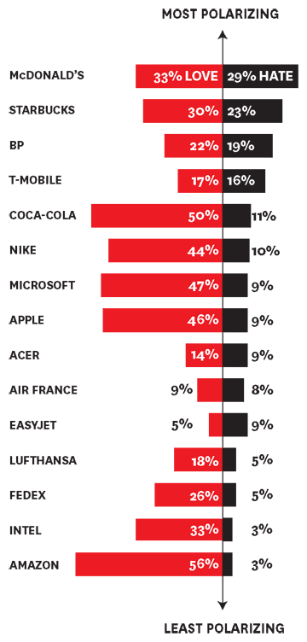
Source:Yougov Brand Index

Slide 25
Brand Love (Batra ,Ahuvia and Bagozzi: Journal of Marketing ,2011)

Slide 26
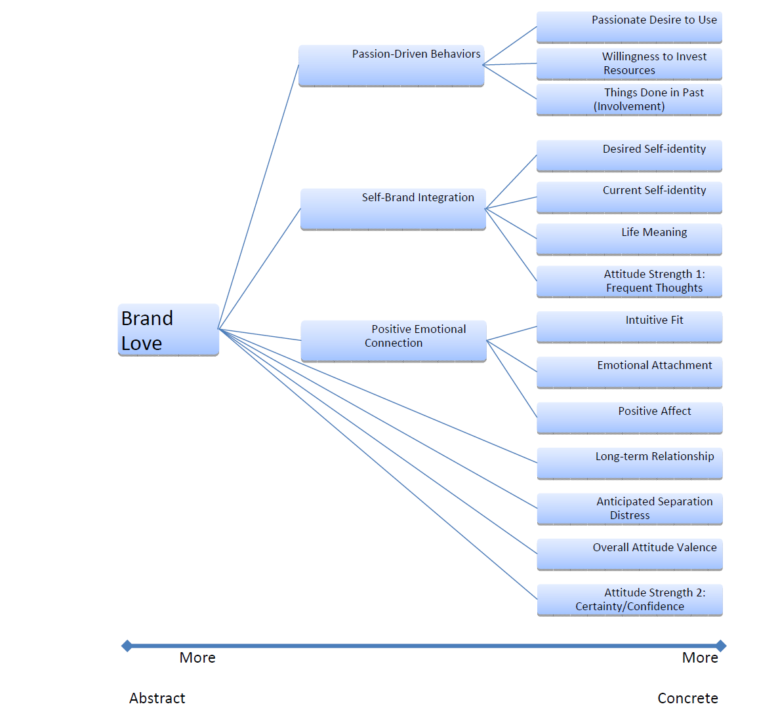

Slide 27
Resonance
Behavioral loyalty
Attitudinal attachment
Sense of community
Active engagement

Slide 28

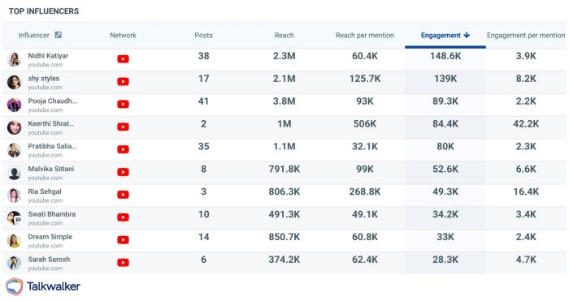

Slide 30
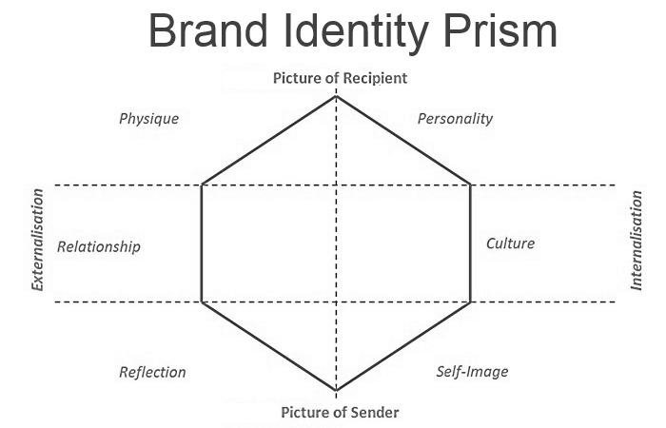
Kapferer’s model

Slide 31
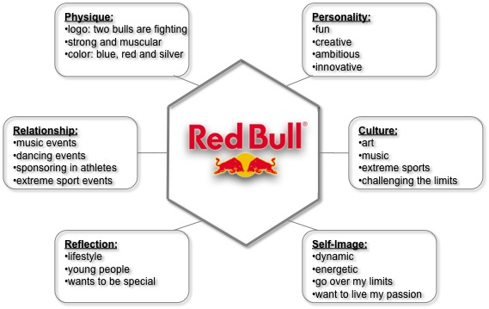

Slide 32
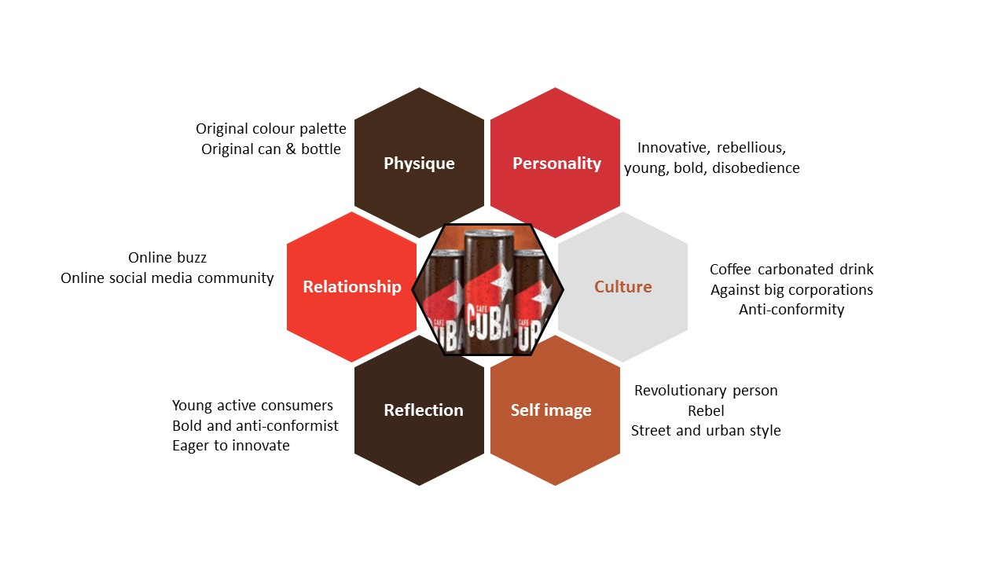

Slide 33
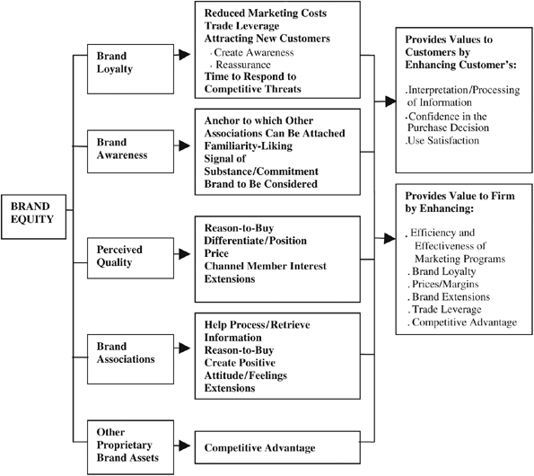
Brand Equity (Aaker)

Slide 34
Aaker’s model of Brand identity

Slide 35
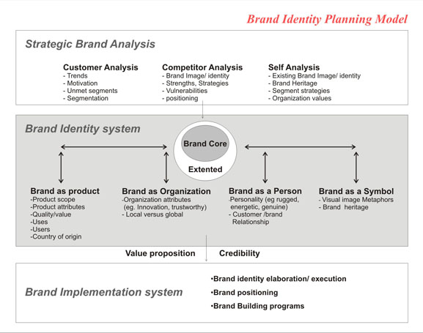

Slide 36
How smart brands command a price premium (Source:Nigel Hollis,Milward Brown, www.mb-blog.com)
Find out who values your brand most
A single minded focus on functional advantage and value perceptions may be enough to create a short –term boost, but for the long term build an emotional connection
Challenge is to sustain the “feelings of difference”
Building perceptions of superiority and value
Shift the focus
Avoid death by a thousand cuts !

Slide 37
Product and Service branding
How to Manage Different Category of brands
Current practice and Real Life cases

Slide 38
Defining Consumer facing Internet brands / DTC brands
DTC/Digital native vertical brands (Dunn, 2017; Prenskey, 2001; Schlesinger et al, 2020)
“Brands that are elevated from the digital context and are offered directly to consumers primarily using online channels , co-create value and rapidly transform into successful master brands”

Slide 39
Background -Flourish Vs Fizzle
D2C phenomenon in US
Many unicorns
Web only retail
Direct distribution
Blanding
Bonobos
Warby Parker
Casper
Dollar Shave Club
Everlane
Harry’s
The Honest Company
Glossier
Allbirds
Away

Slide 40


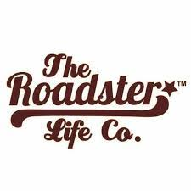


Indian context

Slide 41



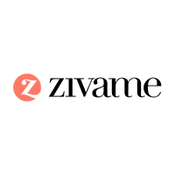
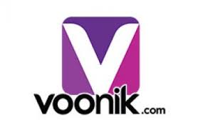


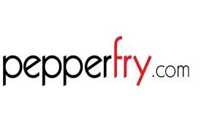

Slide 42
2-3 year- USD 15 million to 25 million sales
Inflection point for hybrid channel journey?
Brands across four key stages of digital marketing maturity; nascent, emerging, connected, and multi-moment (Google and BCG study, 2019)
80% of Indian brands either in second or third stage

Slide 43
Case selection
Boat Lifestyle
Wakefit
Mamaearth (Honasa consumer pvt ltd)
Wow skin science

Slide 44
Snapshots
“Around 90% of Indians still love loud bass. It is in our culture, such as tabla and dhol. That is why our products were tuned to Indian preferences” (Interview- Boat)
“The Apple cable used to break near the charging end (near the connectors). People used to make do, by taping over it. So we launched a tough, braided cable, with a life cycle of 10,000 bends” (Interview –Boat)
“Most people, especially women, are not comfortable lying on a bed in front of people. Also, you cannot really know if you are comfortable in a bed till you use it overnight for a while. That’s why we give 100 day-return period with 100 percent refund” (Wakefit –interview)

Slide 45
“With the plethora of decisions a person has to make in a single day, we want to simplify consumer's life by helping them make at least one less decision”.
"We want to democratize sleep and for that it is important to ensure affordability”
“Internet adopters were our first users. We visited homes for our first 100 deliveries, and did video interviews for feedback.“ (Interview – Wakefit)
“More than just providing products, we believe in providing solutions to everyday problems that new parents face, and thus reducing their stress” (Interview -Mamaearth)

Slide 46
“We are like the Zara of electronics. We are not highly priced, like some luxury brands, and neither low priced, like Chinese electronics”
“As an online brand, your products are constantly subjected to reviews. The quality is extremely critical in this case. Millennials are ready to give you a try, but they are also the first ones to write you off if you can’t deliver”
“I have not spent a rupee on Google (ads) and TV. So while there is no direct ROI metrics for influencer marketing, it greatly helps us spread the word” (Interview –Boat)

Slide 47
“Going to the store and buying was a stupid way of purchase; feeling the product for five-ten minutes was a faulty way of buying,” (Wakefield - Interview)
“Our brand’s “Customer First” strategy worked, and it truly is to the credit of our customers that WOW grew through word of mouth reviews. Figuring out the art of marketing our products online through Facebook/Google in both India and the USA at a reasonable Cost of Acquisition also contributed to our upturn. In addition, we really hustled and began working with tons of quality micro-influencers, helping us spread brand awareness to a completely new market “(Interview - Wow science)

Slide 48
“We are a 'mum-powered' company and work with a large number of mothers who are involved in the process, right from ideation, conceptualization to the actual product launch. We believe this connection with mothers will continue to be the biggest driver of success. We have more than 200 young moms on board who help us in conceptualizing and formulating the products. The moms then test these products, and only those with great feedback are approved for mass production” (Interview -Mamaearth)

Slide 49
“Above all other unique qualities, WOW Skin Science is proud to have a customer-first approach. I use the term “customers” loosely, as we consider each and every person who uses our products to be our ambassador and a part of the WOW team. Being invested in what your ambassadors are saying, delivering what they want, and giving an exemplary experience is the key to customers advocating for your brand, spreading the word, becoming repeat purchasers, and assuring them their voices are valued” (Interview- Wow )

Slide 50
Focus on users lives : Position on users lives by endearing to a passionate core of customers
Syncretic brands
Veiled imitation of successful models
Brand intimacy through passionate community building
Customer experience and RoI (Amazon and DTC vs legacy brands, Fulgoni, 2018)
Sense and respond business model

Slide 51
Themes
Consumer Liberation
User focus
Convenience maximalism
Grassroots insights
Cultural acceleration
Syncretic branding
Cool, rebellious
Logical and no- nonsene
Climber - Brandphiles
Aspirational peer
Authenticity
Communal connection& engagement
Brand Intimacy
Content, Coversations
Rituals

Slide 52
Veiled imitation
Platform imitation
Agile and lean model
Sense and respond
On demand sourcing

Slide 53
Casper Sleep Inc.
Not the pioneer in direct-to- consumer mattress (Tufts ‘n’Needle)
$100 mn sales, 1% of $14bn industry
“Nike of Sleep”
free earned media, low cost radio, outdoor to complement web presence
Should it go for traditional TV for a nationwide presence?
What will happen to the “maverick” image?

Slide 54
Awareness → Interest → In-store “trial” → Selection of best model → Purchase → Delivery
The decision making process is different for Casper and the direct customer
Awareness → Interest → Purchase → Delivery → 100-day, at-home trial → Keep
Big Mattress firms have huge margin about 38 % ($961- $2500) Manufacturer profit $ 589
Capser ( $480- $850 )

Slide 55
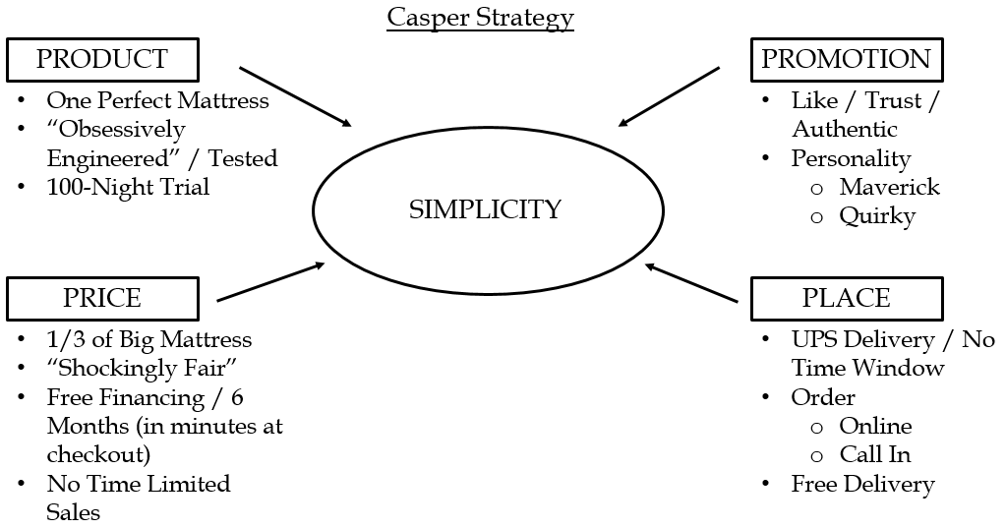

Slide 56
“One perfect mattress for everyone”- offsets retail’s advantage of using sales staff to lead consumer to a perfect match
100 days free trial offsets need for instore trail
Simplicity was a key part of Caspers’ strategy

Slide 57
Economics
COGS = 60%
Outbound delivery = $75
Return rate = 5%
For a $950 bed,
{$540 COGS+$50 promo+ delivery $75+ return $46.25(disposal $25)}
Gross profit = $238.75( 26.5 %)

Slide 58
Competition
While Casper did lot of A/B testing to find the best mattress formula, still it was easy to reverse engineer
Functional differentiation was limited
Brand meaning would be the key differentiator
Satva was 35 % premium to Casper, had own delivery, no compression to box-in, lux positioning - “Luxury can’t be stuffed in a box”
Tuft&Needle- 25% lower segments - Don’t buy that mattress, T&N started it first”
Leesa – Casper clone with a social angle “The better new Mattress”
Casper sought a “quirky, loveable association” and avoided direct comparison to peer group,

Slide 59
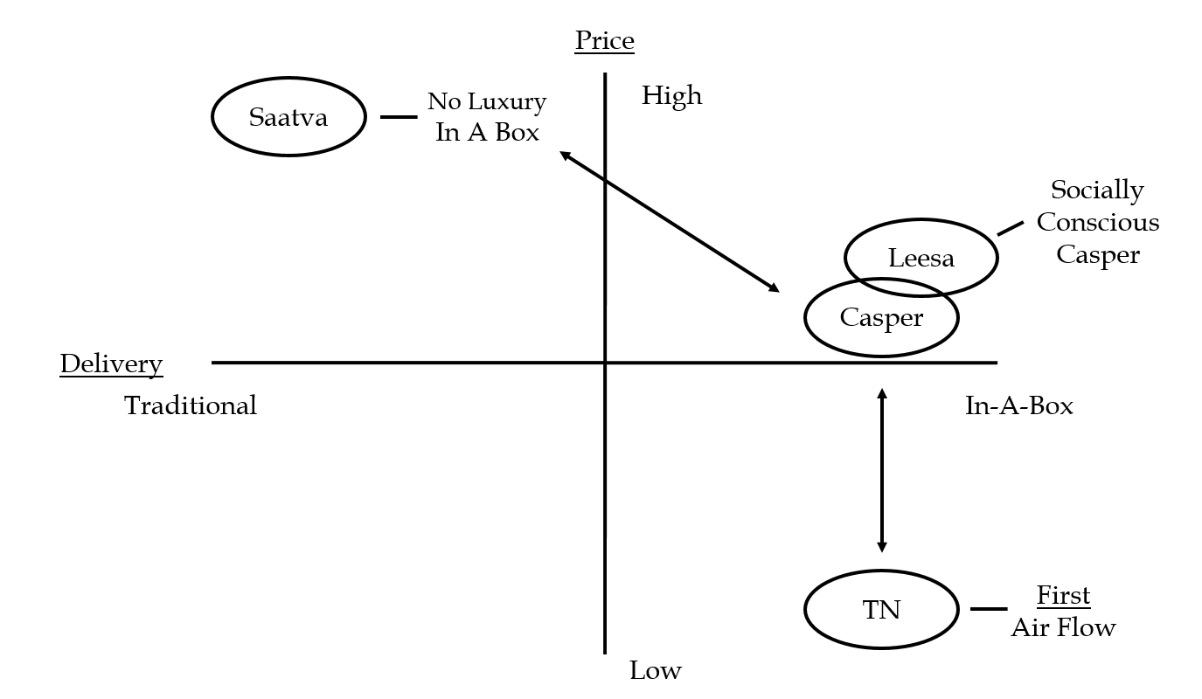

Slide 60
Capser’s Communication has two objectives
The first is to create awareness, knowledge, and interest for the direct model vs. buying in the historical fashion- create demand for the direct-to consumer category
Its second job is to create selective demand within the direct category- inducing consumers to choose Casper over alternatives, like Tuft and Needle, Saatva, or Leesa.
Casper “regarded competition within the direct-to-consumer segment as a good thing” -“a sea of copycats who have tried to mirror us”

Slide 61
Successful with NPS, customer satisfaction, press coverage
Tension between generating short term sales (Krim/Rockovich) and Brand building (Sherwin/Kaplan)

Slide 62
Brand building
Short term sales
“…concerned about sales performance in the short-term, particularly with investors to answer to” (case, p. 2).
“We are obsessive on measurement – with these promo codes uniquely assigned to everyone, we can see who is buying” case, p. 9).
Keep the “Casper standard of rigorously analyzing results to assess impact…” (case,
p. 12), no matter what media used.
“We have great stories – all need to ‘ladder up’ (features, benefits emotion) into the brand we want to build” (case, p. 2).
“Key is for us is a Casper personality and story that builds an emotional bond with consumer … it’s all about brand love” (case p.2)

Slide 63
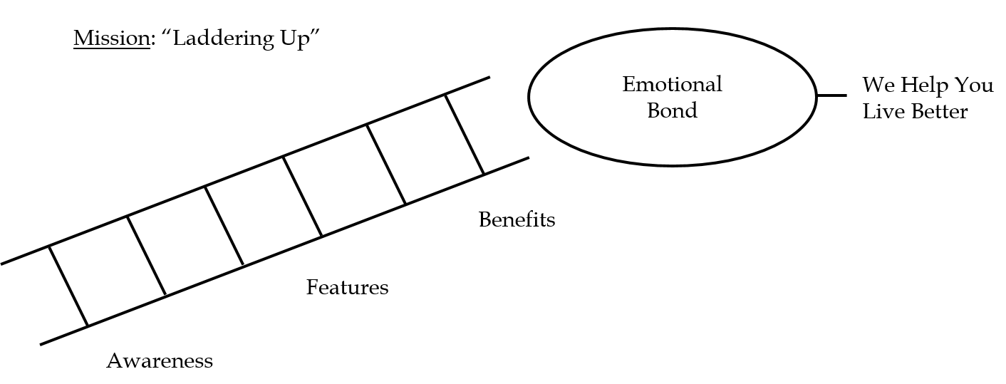

Slide 64
To date Casper has been Successful with both (NPS, press mention, satisfaction etc.)
Casper has a good mix of IMC with a mission - to develop the Casper brand as the loveable, quirky, maverick brand offering relief from the “worst buying experience” in the world as imposed by Big Mattresses
A strong focus on earned media right from the beginning to create a “believable and impactful brand “ -later amplified by paid media
Stories of interest
Also a strong “owned media”

Slide 65
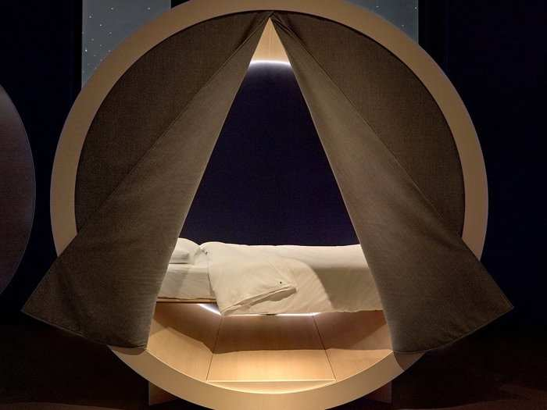
Dreamery sleep pod

Slide 66
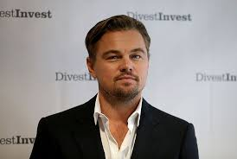
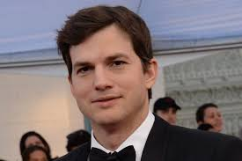
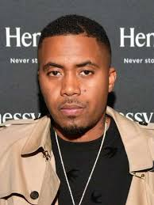
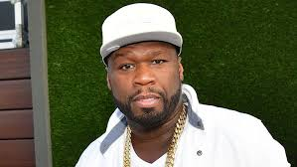
Celebrity Investors!

Slide 67
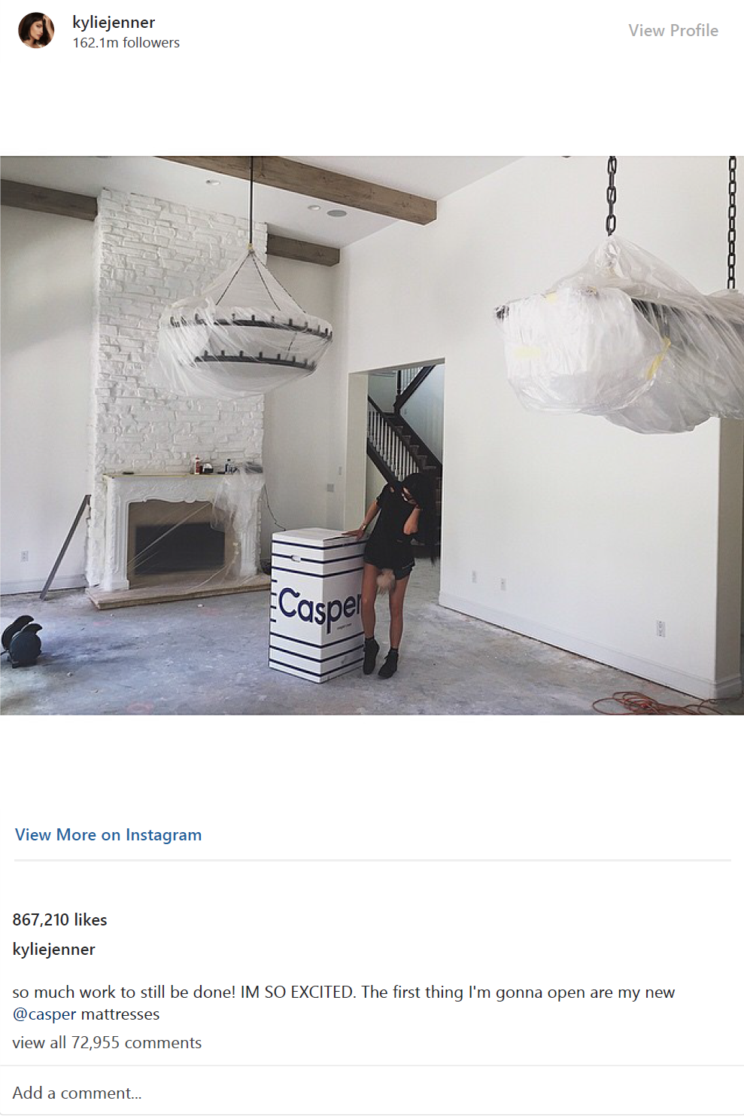

Slide 68
You Tube influencers posted ‘unboxing”videos

Slide 69
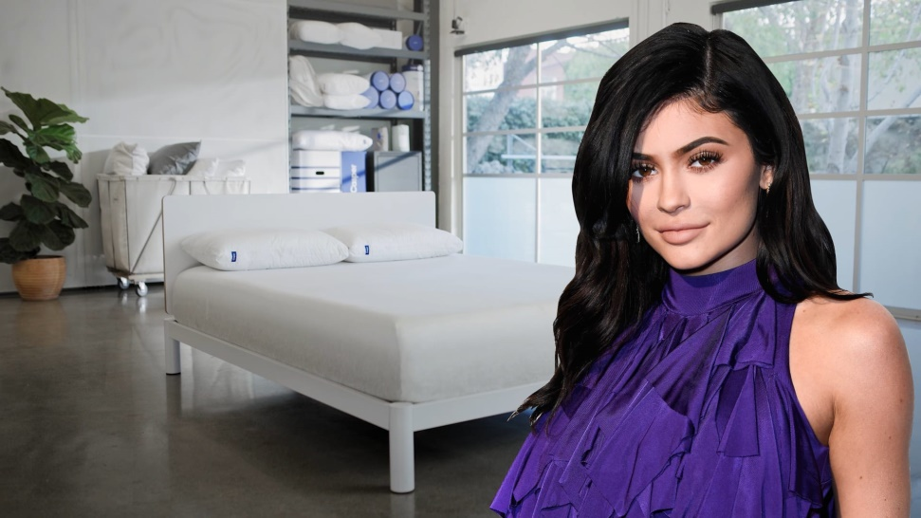
Make –up Moghul
At 21, Kylie Jenner became the youngest self-made billionaire ever
Kylie Cosmetics $330 million (sales grew from 0 to $300 million in the launch year 2015)
“It’s the power of social media,I had such a strong reach before I was able to start anything.” (Jenner)

Slide 70
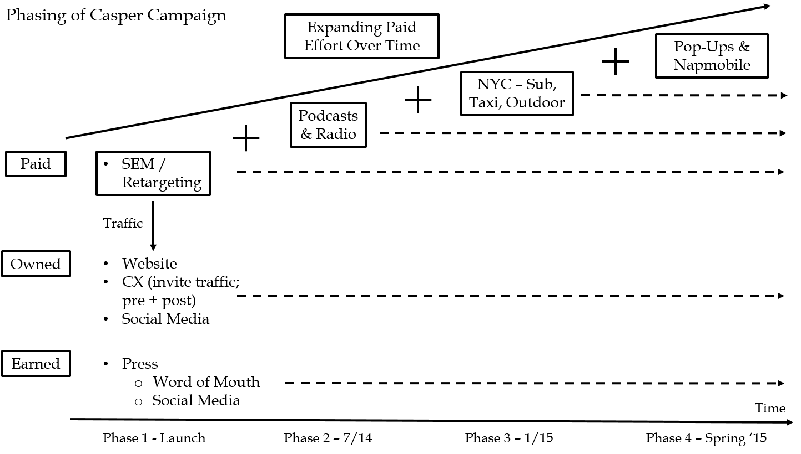

Slide 71
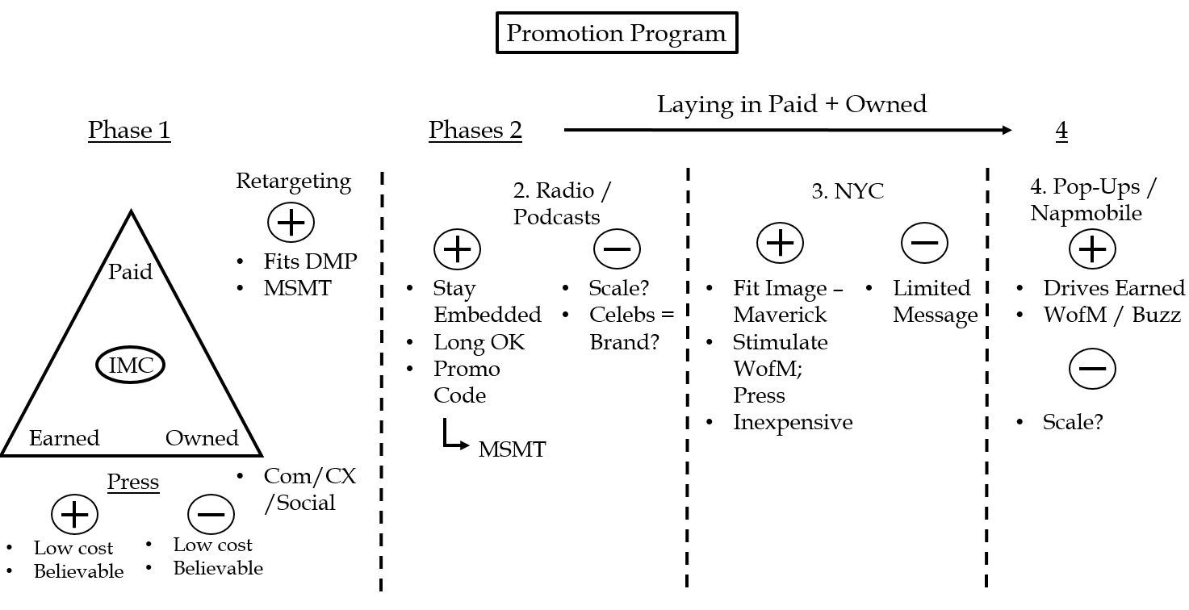

Slide 72
Media selection for Next Phase- TV?
(p. 11) Outdoor: $3 with Casper being “somewhat less” due to remainder deals
(p. 7) Podcasts: $15 for 15 seconds; $25 for 30 seconds
(p. 11) Radio: $10 for 30 second; $12 for 30 with celebrity endorser
TV: $15 for 30 second fringe time, $25 for prime time
TV is traditional where big mattresses are spending $500 mn
Could they do it the “Casper Way”?
For e.g. $ 50 was communication impact measurement way ,not a price play

Slide 73
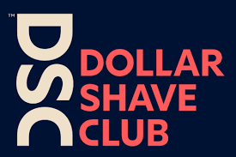
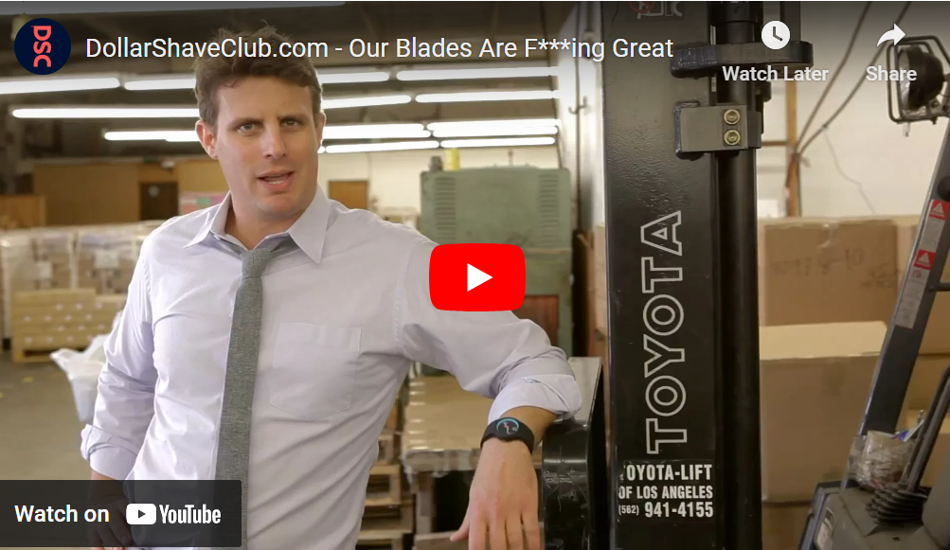
Case2 :Dollar shave club
Why has Gillette successful for over hundred years
What is their value proposition ?

Slide 74
Product evolution over 100 years
Incremental innovation
https://gillette.com/en-us/about/our-story
Business model ? Marketing perspective elements
Who is served – Segmentation &Targeting
What is being served – Customer value proposition & brand positioning
How ? Marketing mix – Product, Price, Promotion, place
Value Chain
Competitive advantage

Slide 75
What is DSC’s Business model?
Value proposition?
“A subscription model works only when it enhances customer experience” – Michael Dubin

Slide 76
2011 $35,000
$200 mn revenue by 2016 !
No own production facilities
A successful DTC (Direct –to –Consumer ) brand, a new gen marketing firm which puts emphasis on Experiential marketing and customer engagement
Perceived Value for money
Economic value &experiential value
DSC offers new elements of value overlooked by Gillette

Slide 77
Segmentation and Targeting
Product benefits, Price/ quality
Frequency/usage
Male Vs Female
Targets the whole market
Target mid-market guys insecure (and lazy)about grooming
Millennials who are lazy to shop offline
Benefits –Convenience, product experience, perceived low price
Gillette
DSC

Slide 78
Positioning
Gillette
DSC
Performance based on Tech
Reliability
Trust
Best a man can get (perfect , close shave)
“hysteresis effect” based on progressive geometry - multiple blades
Customer need- convenience &affordability
Subscription
Experience
Digital native brand
Replacing cartridges
Solving men’s grooming issues
https://www.inc.com/video/how-michael-dubin-built-a-brand-identity-out-of-a-commodity.html

Slide 79
Product
DSC
No patents
No own production
Supplies from Korean firm Dorco
Instead of traditional product based R&D, it has gained competitive advantage consumer insight mining
Marketing content and customer engagement is also part of product offering
“Solves grooming problem for men “- solution company

Slide 80
Price
DSC
Mostly variables costs
No retailer margin DTC
No mass ads
DSC – double marginalization upstream (for Dorco)
More frequent blade replacement thanks to affordability
For Gillette high Fixed costs, R&D – mass marketing –sales force- retailer margins
Gillette , a quasi -duoply suffers from “Double marginalization” – Company margin &retailer margins
Customers may continue using an old blade b’cause of high replacement cost

Slide 81
Pricing models in the internet economy
Access (Air BnB, Uber)
Free (Google, FB)
Freemium (Spotify, Dropbox)
Subscription (Netflix, DSC)
Marketplace – Mixed models (Amazon)

Slide 82
Place
Promotion
DSC is a direct to consumer brand
Convenience of getting products delivered at door step, no hassle of buying razors from the glass fortress’
Online shopping experience and engagement
Retailer can’t add much value to the product category unlike electronics /appliances
Online
Viral videos
Engagement
Community
“Bathroom minutes”
Humour
Making a boring category LIVE

Slide 83
Gillette’s strategic options?
PACADI framework
Problem : Disruptive business model innovation in the category
5CS- Customer, Company, Competition, Collaborators, Context
Business model /Value proposition
4Ps –Marketing Mix
Industry analysis/SWOT analysis

Slide 84
Café Coffee Day
Rejuvenating the brand – need to unlearn some elements of brand knowledge while creating something new
“Coffee and Conversations”
“A lot can Happen over coffee” ( as a third space)
Evolutionary Vs Revolutionary
The CCD café experience and proposition-non-differentiated and generic
The previous brand differentiators (e.g., service, quality of the coffee, accessibility, and value for money) were now the non-differentiating factors in the category

Slide 85
The brand archetype study that Landor conducted clearly highlighted the gap between the brand image and the brand identity.
The brand had a “guy/girl next door” image -archetype made consumers more comfortable with the brand, but a non- aspirational image
CCD always focused on the quality of its coffee and the brewing process- but consumer research showed that these attributes were not as important to consumers: evidently, coffee was only the catalyst and not the focus.
A gap between the brand’s intention and expectations

Slide 86
Create a unique and differentiated product story and experience
This story had to be built around the coffee itself and the way it was brewed/processed

Slide 87
Landor’s recommendation to change the brand archetype to “explorer” had the potential to add new associations to the brand and make it more dynamic and contemporary
The explorer archetype was spirited but not individualistic or alienating
promised an experience that was uplifting, energizing, and youthful, and it fostered an environment of new possibilities and outcomes; it “made things happen” and did more justice to the CCD’s tagline (“a lot can happen over coffee”)

Slide 88
Greater aspiration and dynamism
A more differentiated and powerful identity
Added value in the café experience, making it about more involving, meaningful, and enriching
interactions, rather than simply about comfort and meeting with friends

Slide 89
Good Company -more evolutionary and closer to CCD’s present positioning
Social Hub positioning- more revolutionary and farthest from the current platform
Real Coffee, Real Moments - a safer bet and rested between the two platforms

Slide 90


Slide 91
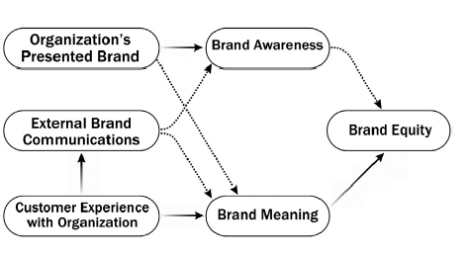
How to Build a Strong Services Brand – Mayo Clinic Case
Services Branding Model

